Slide 1
India’s Unemployment Crisis
Team Members -
Vishwa Shrirame
Ayush Sekhsaria
Usha Bhanu Komaragiri
Ajinkya Pahinkar

Slide 2
Motivation
One of the most crucial measures of a nation’s health is its ability to offer individuals who want jobs, a place to work. As a result, the unemployment rate which reflects the inability to create such employment becomes the most crucial sign of how well a modern economy is doing.
A rise in unemployment weakens overall consumer spending, slows the economy, and most significantly, makes people more vulnerable to changes in the economy.
The year 2020 was a period when the world experienced severe disruption in daily activities with the rise of the COVID-19 Pandemic. Thousands of people lost their jobs and a lot of families were affected by it. Due to the pandemic, the unemployment rate rose to 20.9% during the April-June quarter of 2020 which was more than double the unemployment rate in the same quarter the previous year.
We want to understand what factors are responsible for the rise and decline of unemployment rate’s in Indian States. Our main motivation is to enlighten these factors and represent our results using various visualization techniques.

Slide 3
Objectives
The contribution of our work will focus on all the factors we think are responsible for the unemployment rates across India.
How has covid-19 affected the unemployment rate in India?
Which states do we observe a high/low unemployment and employment rate? What could be the factors?
Is education an important factor that affects the unemployment of the state?
Does the GDP per Capita affect the unemployment rate of that particular state?
How’s labor participation spread in India? Is it more in rural areas or urban areas?
We aim to tackle these questions with the help of visualization techniques and derive insights from it.

Slide 4
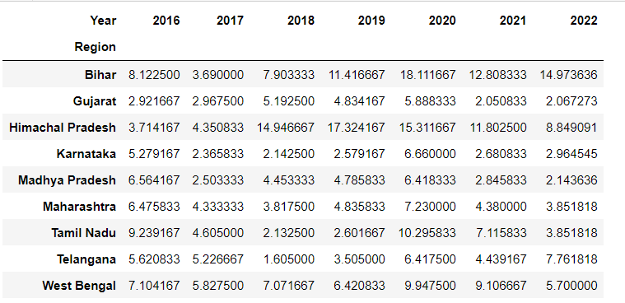
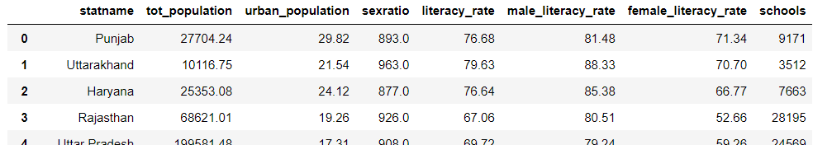
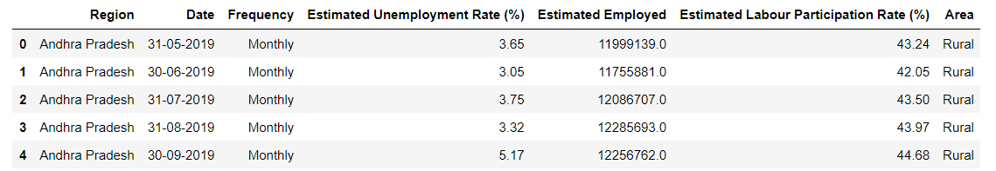
Datasets
Notes:
Top-Left = GDP data
Top-Right = Education data
Bottom = Unemployment statistics data

Slide 5

GDP-per capita growth from 1996 to 2020

Slide 6
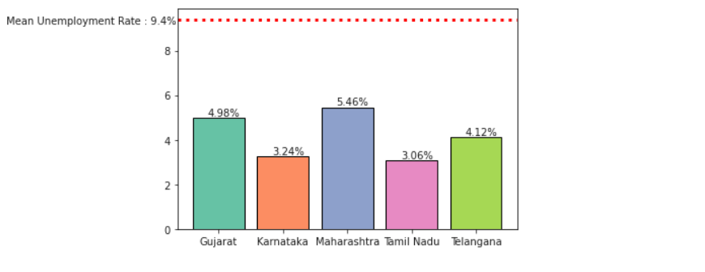
Impact of GDP per capita on Unemployment
We have identified states Maharashtra, Gujarat, Karnataka, Tamil Nadu and Telangana as the top states that have been consistently performing better as compared to the other states.
We observe that the unemployment rate for the top performing states are well below the the mean rate.
We will infer that unemployment rate is less on an average for top performing states in terms of GDP per capita.
Notes:
The mean unemployment rate of the whole country for the year 2019 was 9.43% (marked by the red dotted line).

Slide 7
We notice large patches when the slider hits the year 2020 that may be due to the COVID-19 pandemic.

Slide 8
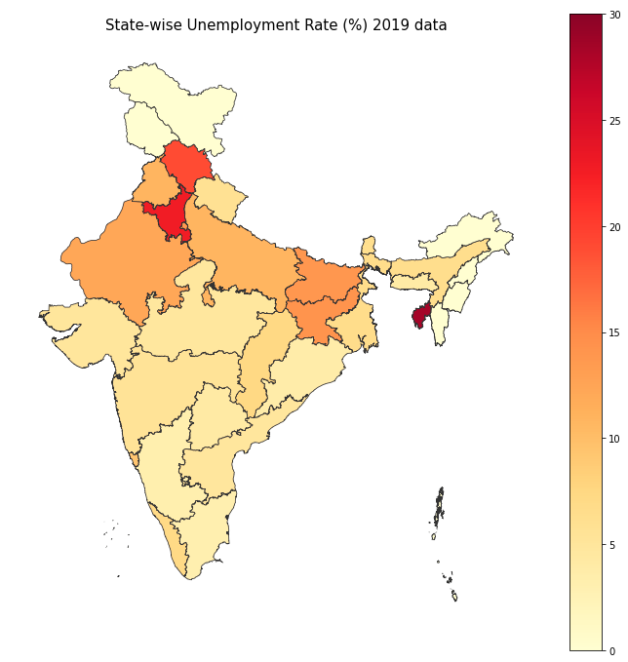
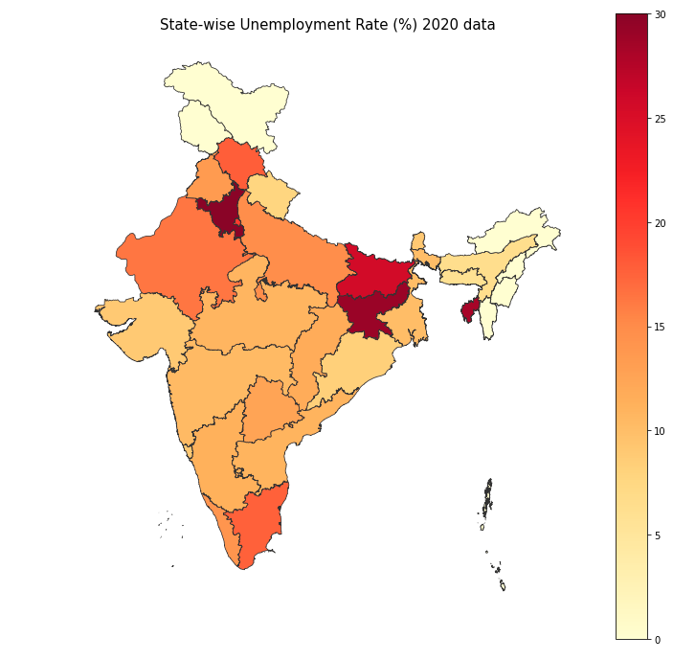
Impact of COVID-19 on Unemployment
We have plotted two choropleth maps indicating the spread of unemployment rates across the country.
We observe that most of the states have a darker shade in the 2020 choropleth map which indicates that COVID-19 was a huge factor in the unemployment increase in the country.
Notes:
However, we can understand better if we have certain metrics indicating how much unemployment rates grew from 2019 to 2020.

Slide 9
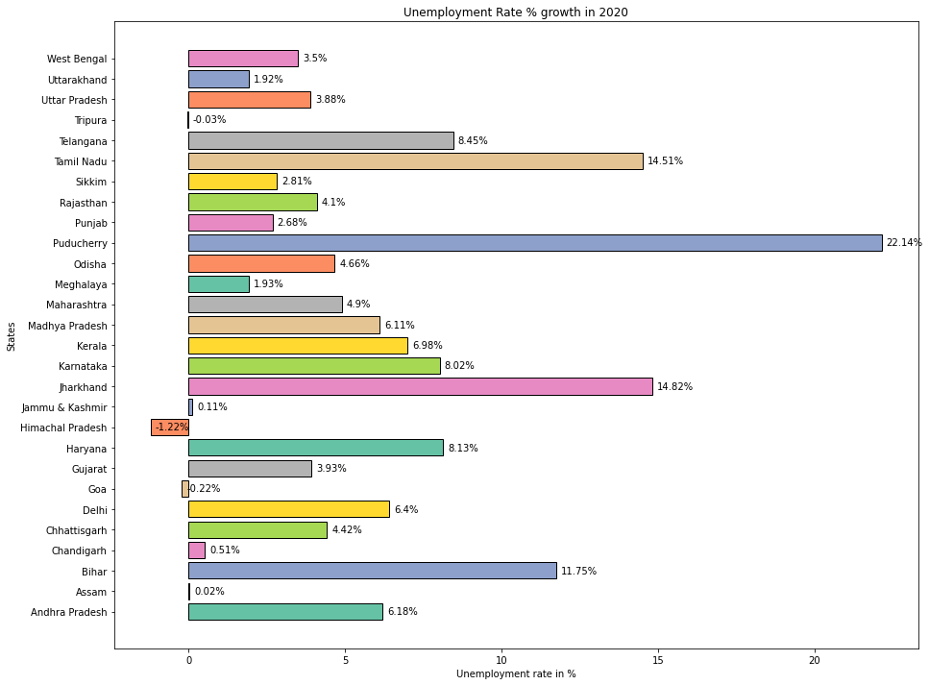
Unemployment Rate growth in 2020
Apart from states like Tripura, Jammu & Kashmir, Himachal Pradesh, Assam, Goa and Chandigarh, we see a significant rise in the unemployment rates across India.
States such as Telangana, Tamil Nadu, Maharashtra, Haryana and Jharkhand that houses majority of the industries have had a significant impact on unemployment rates due to the pandemic.
Notes:
As industrialization is not widespread across the country, states such as Jammu & Kashmir, Himachal Pradesh, Assam that lie towards the north experience less impact due to the COVID-19 pandemic.
The unemployment rate in Puducherry was 1.7% in 2019 and as per Fig 9, this state was impacted the most due to the pandemic. It recorded a rise of 22.14% in it’s unemployment rate. On further research, we found that Puducherry’s vital sectors was not given priority by the government which explains the meteoric rise.

Slide 10
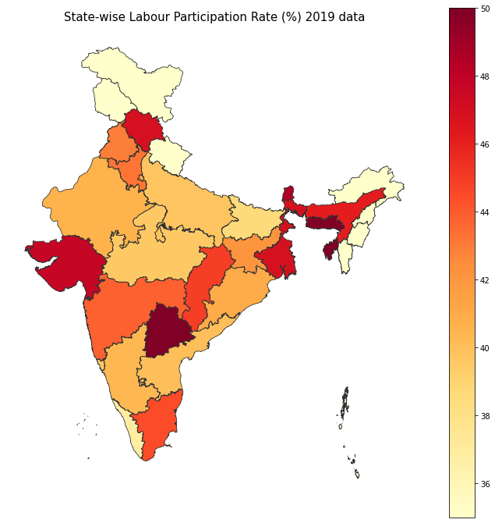
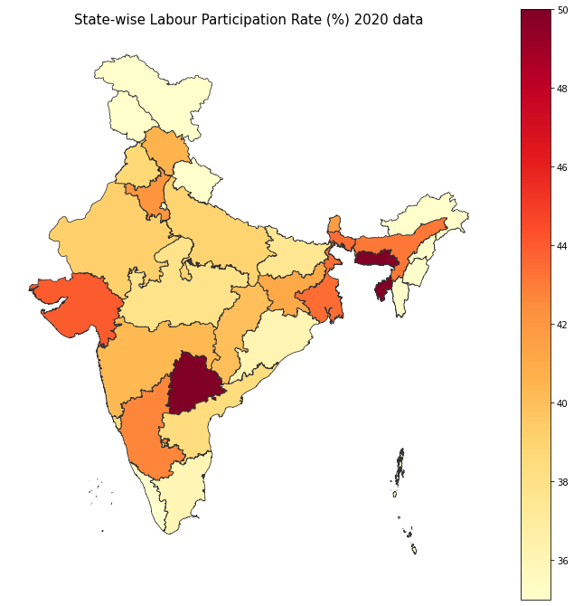
Impact of COVID-19 on Labour Participation
In the year 2019, labour participation rate was widespread across the country as seen by the darker shades in majority of the states. However, most of the states have a lighter shade in the year 2020 due to the COVID-19 pandemic.
Notes:
Labour participation comprises of people who supply labour for the production of goods and services in various sectors
Since there was a nationwide lockdown imposed in the country, labour activities had to come to a stop for a brief period.
It has been a major impact on people’s lives who’s livelihood depended on labour work. India accounts for 501 million people [10] who are working as labourers and such an impact due to the pandemic has been atrocious.
We will again use bar charts to understand the decline of labour participation numerically across all the states.

Slide 11
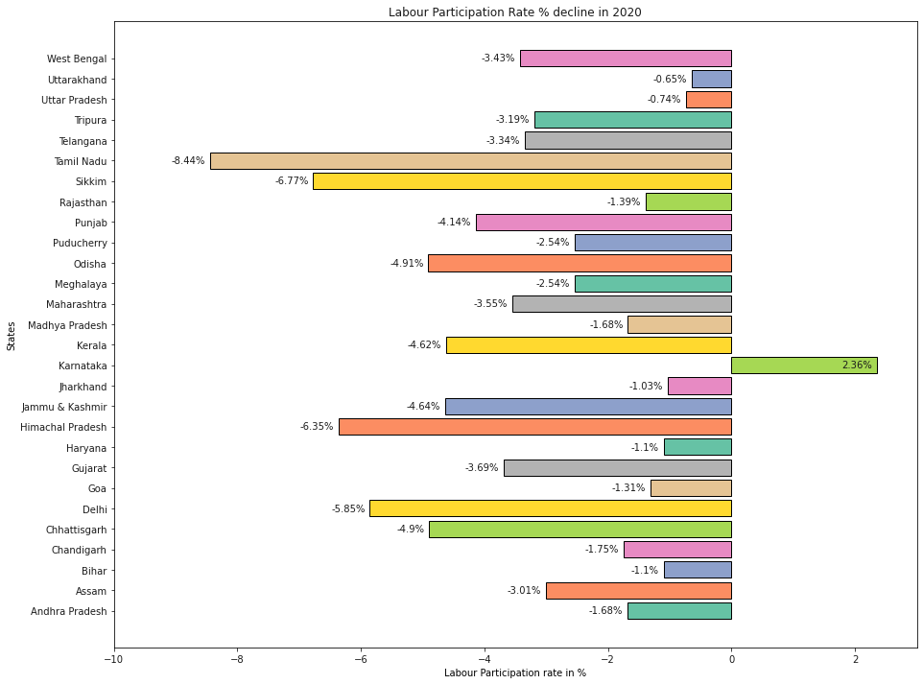
Labour Participation decline in 2020
It’s certain that due to the nation-wide lockdown because of the COVID-19 virus, governments had to take harsh measures by stopping all the outdoor activities.
However, there’s an outlier in the visualization as the labour participation rate in Karnataka increased during the pandemic.
Notes:
On further research, we found that during the quarter April - June 2020, Urban Karnataka has seen a rise in women’s participation in labour force which increased from 22.1% to 27.2%.

Slide 12
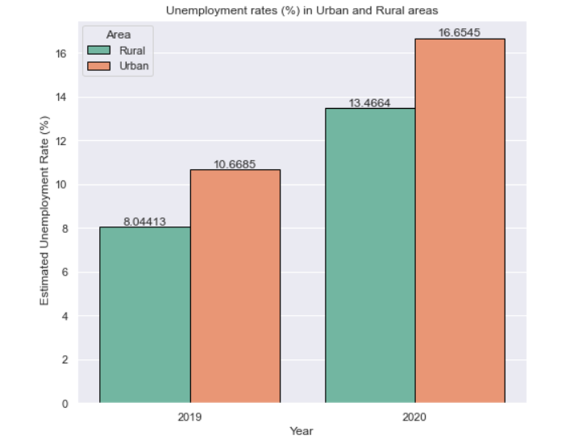
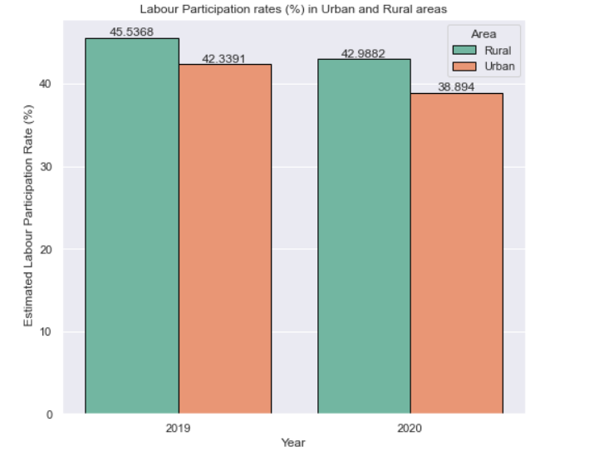
Impact of COVID-19 on Urban and Rural Areas
We observed that Urban areas were impacted more in unemployment rate due to the COVID-19 pandemic than Rural areas. This is expected as most of the employment opportunities are present in Urban areas.
Notes:
Labour participation is more in rural areas than Urban areas.

Slide 13
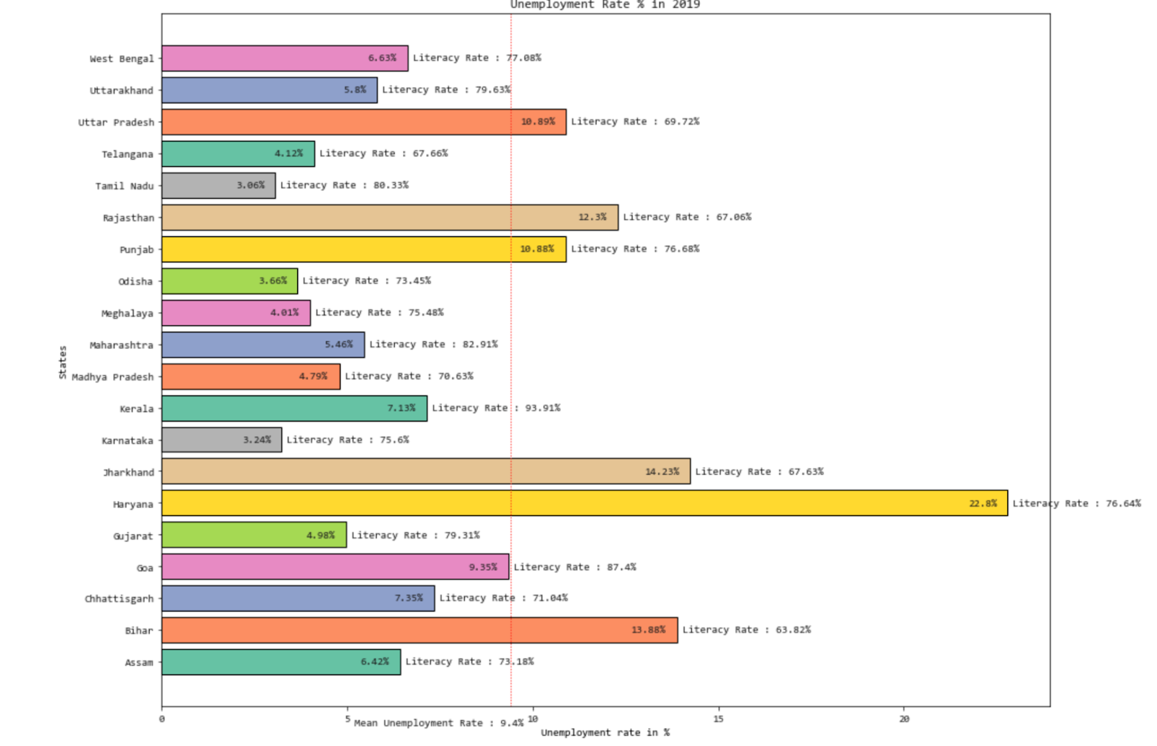
Impact of Literacy rate on Unemployment
The states like Uttar Pradesh, Rajasthan, Jharkhand and Bihar have a low literacy rate and high unemployment rates. We can infer that literacy among people may be a factor for high unemployment rates.
However, states like Punjab and Haryana who have a high literacy rate also have high unemployment rates.
We can also see that for states like Madhya Pradesh and Telangana, who have a low literacy rate and a low unemployment rate.

Slide 14
Failed experiment?
We experienced a mix-bag of results from this comparison of literacy rates and unemployment rates.
It becomes difficult to infer from such insights and as there are observations for both sides and thus we count this experiment in failed experiments.
We can say that we didn’t get enough evidence to prove that literacy rate had any impact on the unemployment rates in India. Although, it was interesting to learn from this comparison.
We will experiment further by considering other educational factors like number of schools, academic graduation statistics as future work for this project.

Slide 15
Conclusion
Our goal was to tackle the questions addressed in the objectives for this visualization project.
We used various visualization techniques such as choropleth maps, bar charts, bar chart race, sunburst plots and scatter geo plots.
There was a major impact of COVID-19 pandemic on the unemployment crisis in India.
We found a possible relation between GDP per capita and unemployment in India. For top-performing states in terms of GDP per capita we found less unemployment rates.
Due to COVID-19, Urban areas were affected most by unemployment and rural areas were affected most by the labour participation rate.
There was no concrete inference from the relation between literacy rates and unemployment rates.

Slide 16
Future Work
Continuation of our work in identifying other educational factors like the number of schools in States, academic graduation statistics of the population that relates to the unemployment rates across all States.
Deeper analysis on Male and Female unemployment rates and factors leading to the rise/decline of them.
Consider more factors that could affect unemployment rates like government initiatives on employment programs, sector-wise industry layoffs etc.

Slide 17
THANK YOU.

